Slide 1
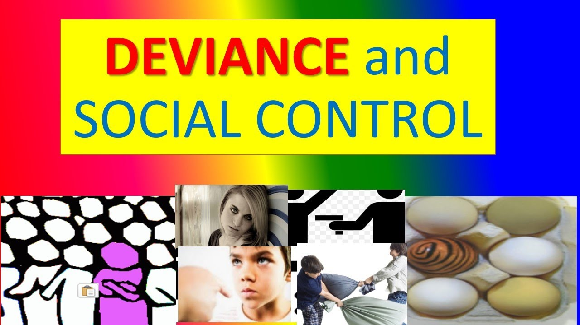
Deviance & Social Control
Ms. Shahtaj Shakir Sociology lecture FAST NUCES

Slide 2
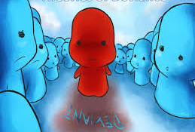
Learning outcomes:
Defining Conformity, deviance, the need for norms.
Sanctions
Contrast sociobiological, psychological, and sociological explanations of deviance.
Different perspective related to deviance
1) Symbolic interactionist perspective
2) functionalist perspective
3) conflict perspective

Slide 3
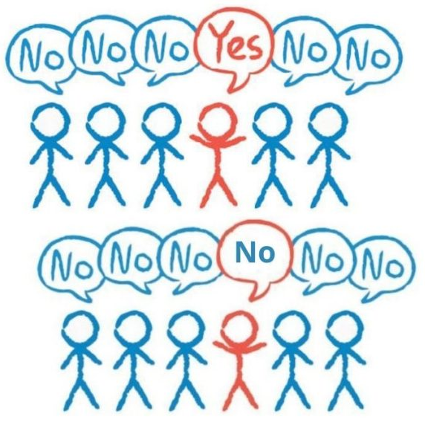
Conformity
Conformity, the process whereby people change their beliefs, attitudes, actions, or perceptions to more closely match those held by groups to which they belong or want to belong or by groups whose approval they desire. Conformity has important social implications and continues to be actively researched.
Examples:
wearing certain types of clothing to fit in with a group
changing your political beliefs to match those of your friends or family
Going along with the crowd even if you don't agree with what they're doing.

Slide 4

No culture or society has complete behavioral conformity.
Deviance exists in all societies

Slide 5
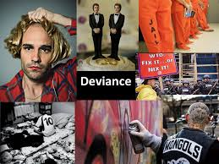
Deviance
Deviance is a socially defined construct that refers to any action, belief, or human characteristic that members of a society or a social group consider a violation of group norms for which the violator is likely to be censured or punished.
It refer to any violation of norms, whether the infraction is as minor as driving over the speed limit, as serious as murder.
Sociologically, no act, belief, or characteristic is inherently deviant because deviance is socially defined.

Slide 6
Behavior that violates the standards of conduct or expectations of a group or society.
Involves violation of group norms, which may or may not be formalized into law
Subject to social definition within a particular society and at a particular time.
Deviance is relative: there is no absolute way of defining a deviant act, vary across societies and from one group to another within the same society.

Slide 7
How Norms Make Social Life Possible?
No human group can exist without norms: Norms make social life possible by making behavior predictable.
Without norms, we would have social chaos. Norms lay out the basic guidelines for how we should play our roles and interact with others. In short, norms bring about social order, a group’s customary social arrangements.
Our lives are based on these arrangements, which is why deviance often is perceived as threatening: Deviance undermines predictability, the foundation of social life.

Slide 8

Consequently, human groups developed a system of social control—formal and informal means of enforcing norms.
At the center of social control are sanctions.

Slide 9
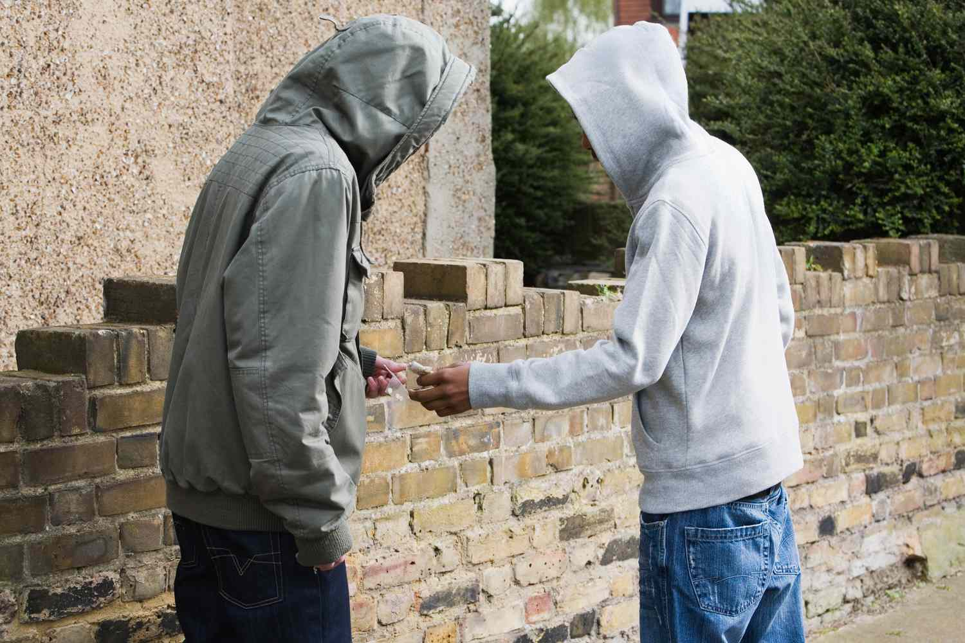
Shifting Definitions of Deviance
What is thought to be deviant will vary from one time period to another.
Some behaviors were once not seen as deviant but now are (for example, obesity) while other behaviors were once seen as deviant but now are not (for example, premarital sex).
What is thought to be deviant will also vary geographically.

Slide 10

Biological explanations:
Sociobiologists explain deviance by looking for answers within individuals. They assume that genetic predispositions lead people to such behaviors as juvenile delinquency and crime (Lombroso 1911; Wilson and Herrnstein 1985; Barnes and Jacobs 2013).
People with “squarish, muscular” bodies were more likely to commit Street crime—acts such as mugging, rape, and burglary.
These theories were abandoned when research did not support them.

Slide 11
Psychological explanations:
Psychologists focus on abnormalities within the individual.
Instead of genes, they examine what are called personality disorders. Their
supposition is that deviating individuals have deviating personalities (Mayer 2007; Liu 2014) and that subconscious motives drive people to deviance.
Deviance is not associated with any particular personality.

Slide 12
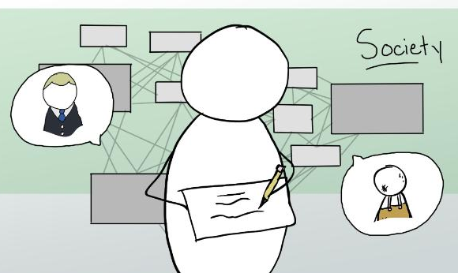
Sociological explanations:
In contrast with both socio-biologists and psychologists, sociologists search for factors outside the individual. They look for social influences that “recruit” people to break norms. To account for why people commit crimes,
For example, sociologists examine such external influences as socialization, membership in subcultures, and social class.

Slide 13

To explain deviance, sociologists apply the three sociological perspectives:
Symbolic interactionism,
Functionalism, and
Conflict theory.
Let’s compare these three explanations.

Slide 14
1. SYMBOLIC INTERACTIONIST PERSPECTIVE
The basic idea of symbolic interactionism is that we are thinking beings who act according to how we interpret situations.
Let’s consider how our membership in groups influences how we view life and, from there, our behavior.

Slide 15
Differential association Theory:
Sociologists stress our experiences in groups.
Edwin Sutherland’s term this to indicate that from the different groups we associate with, we learn to deviate from or conform to society’s norms (Sutherland 1924, 1947; Rendon 2014).
Family/Friends/neighborhoods:
family makes a big difference in whether people learn deviance or conformity. Researchers have confirmed this informal observation. Of the many studies, this one stands out: Of all prison inmates across the United States, about half have a father, mother, brother, sister, or spouse who has served time in prison (Sourcebook of Criminal Justice Statistics 2003:Table 6.0011; Glaze and Maruschak 2008:Table 11).
In short, families that are involved in crime tend to set their children on a lawbreaking path.

Slide 16
Control theory
Sociologist Walter Reckless (1973), who developed control theory, stressed that we have two control systems that work against our motivations to deviate.
Our inner controls-include our internalized morality—conscience, religious principles, ideas of right and wrong. Inner controls also include fears of punishment and the desire to be a “good” person (Hirschi 1969; Gottfredson 2011).
Our outer controls- consist of people—such as family, friends, and the police—who influence us not to deviate.

Slide 17
Labeling theory (the significance of reputations)
The view that the labels people are given affect their own and others’ perceptions of them, thus channeling their behavior into either deviance or conformity.

Slide 18
2. FUNCTIONALIST PERSPECTIVE
When we think of deviance, its dysfunctions are likely to come to mind. Functionalists point out that deviance also has functions.
Can Deviance Really Be Functional for Society?

Slide 19
The classic functionalist theorist Emile Durkheim (1893/1933, 1895/1964) came to a surprising conclusion. Deviance, he said—including crime—is functional for society. Deviance contributes to the social order in three ways:
Deviance clarifies moral boundaries and affirms norms.
Deviance encourages social unity.
Deviance promotes social change.

Slide 20
1. Deviance clarifies moral boundaries and affirms norms.
By moral boundaries, Durkheim referred to a group’s ideas about how people should think and act.
Deviance challenges those boundaries. To call a member into account is to say, in effect, “You broke an important rule, and we cannot tolerate that.” Punishing deviants affirms the group’s norms and clarifies what it means to be a member of the group.

Slide 21
2. Deviance encourages social unity.
To affirm the group’s moral boundaries by punishing deviants creates a “we” feeling among the group’s members. By saying, “You can’t get away with that,” the group affirms the rightness of its ways.

Slide 22
3.Deviance promotes social change.
Not everyone agrees on what to do with people who push beyond the accepted ways of doing things. Some group members may even approve of the rule-breaking behavior. Boundary violations that gain enough support become new, acceptable behaviors.
Deviance, then, may force a group to rethink and redefine its moral boundaries, helping groups and whole societies to adapt to changing circumstances.

Slide 23
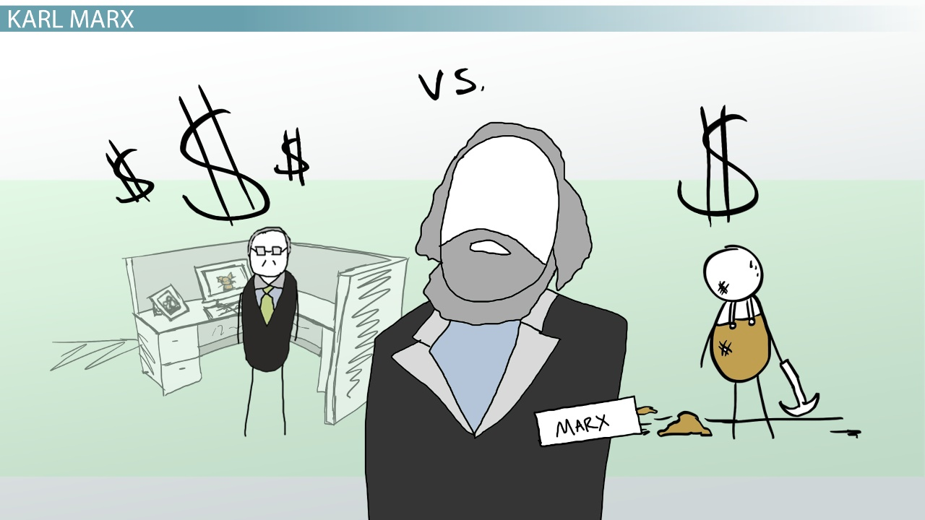
3. The Conflict Perspective
Conflict perspective sees society as a competition for power and resources.
The conflict theory of deviance claims that deviance is the result of inequality in society.
It also argues that deviance is punished more strictly for those with less power. At the same time, the elite in society is much more likely to get away with crime.

Slide 24
Deviance and the Poor
Deviance is created by the capitalist economic system.
Definitions of deviance serve the interest of the capitalists while adversely affecting the poor.
Deviance and the Elite
Great efforts are made by the capitalists to legitimize elite acts of deviance.
The higher-ups in society have greater ability to commit deviant acts, to escape sanction for those acts, and to create scapegoats to blame for those acts.

Slide 25
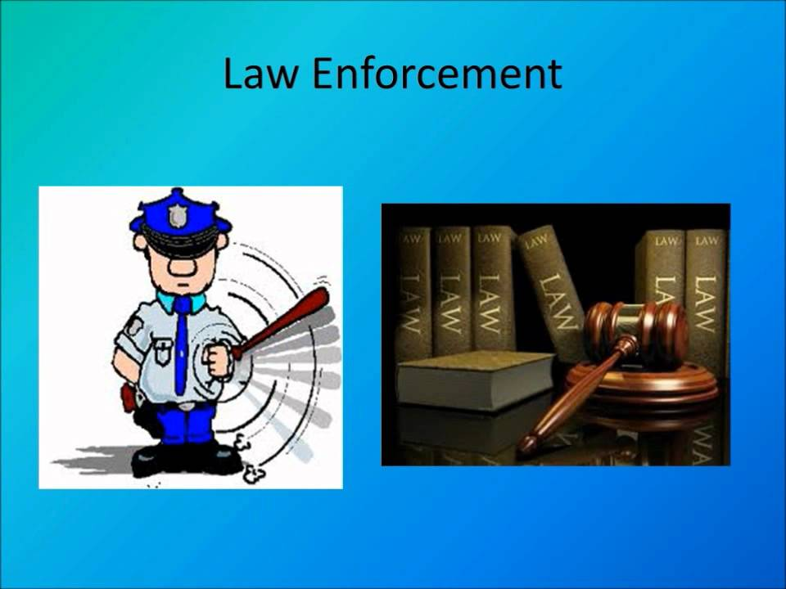
Social control leading to Sanctions
The goal of social control is to maintain order in society and ensure conformity in those who are deemed deviant or undesirable in society which results in sanctions,
A sanction is any reaction from others to the behavior of an individual or group.
Social sanctions encourage behaviors that are considered to be appropriate and deter behaviors that are not.
These representative or typical patterns and rules of behavior are called social norms.

Slide 26
Two types of Sanctions
Negative sanctions: an expression of disapproval for breaking a norm, ranging from a mild, informal reaction such as a frown to a formal reaction such as a fine or a prison sentence.
Eg: being fired is a negative sanction, getting an F is a negative one.
Positive Sanctions: an expression of approval for following a norm, ranging from a smile or a good grade in a class to a material reward such as a prize
Eg: Getting a raise is a positive sanction, Getting an A in Intro to Sociology is a positive sanction
Reference: down to earth book

Slide 27
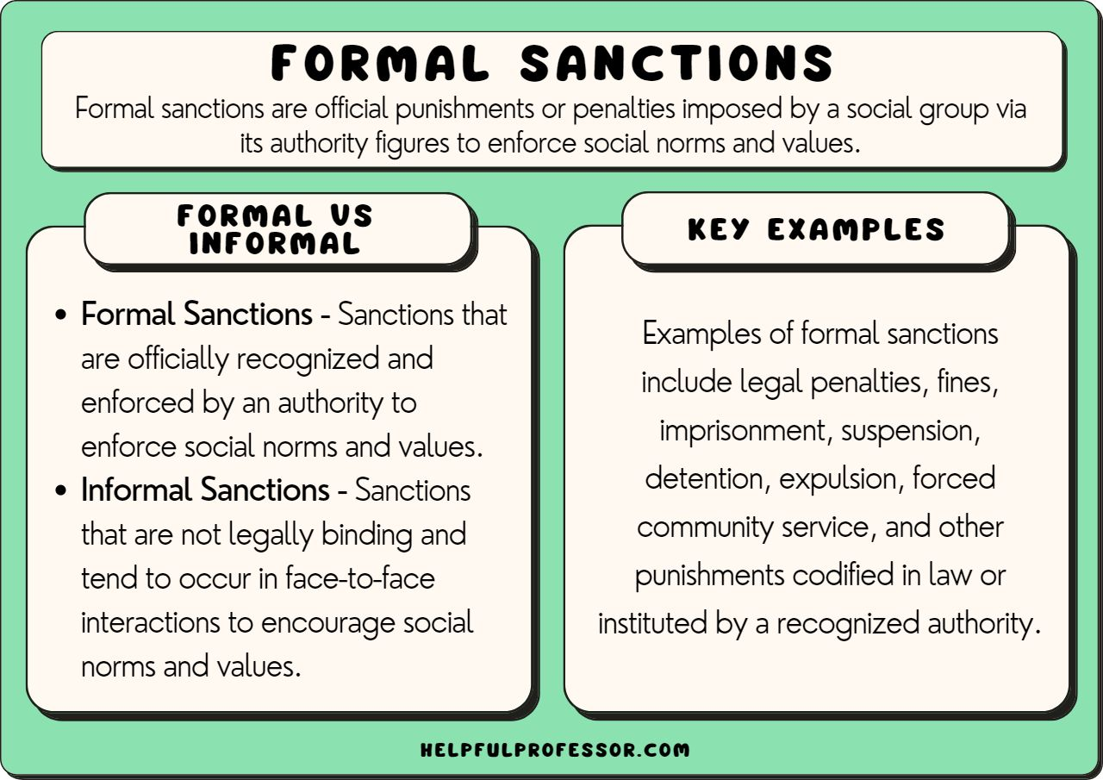

Slide 28
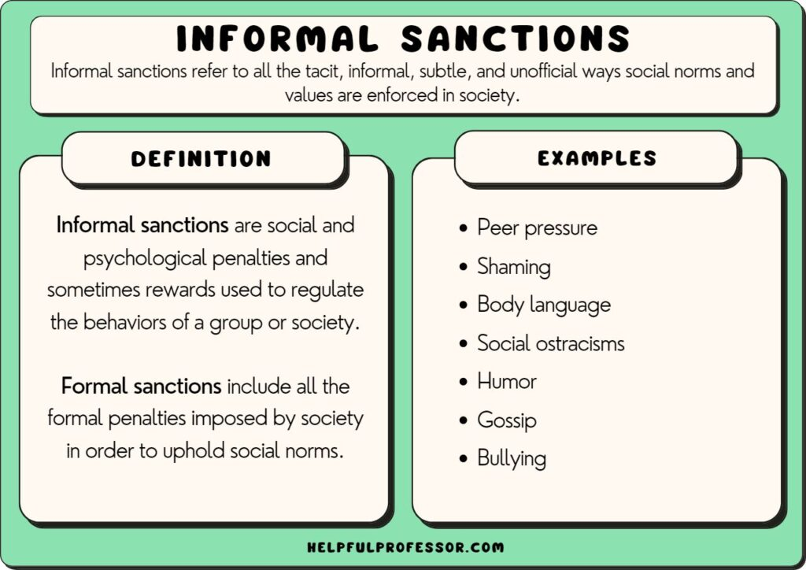

Slide 29
THINK ABOUT A DEVIANT BEHAVIOR AND WHAT KIND OF INFORMAL SANCATION YOU APPLIED TO STOP IT?

Slide 30


